Slide 1
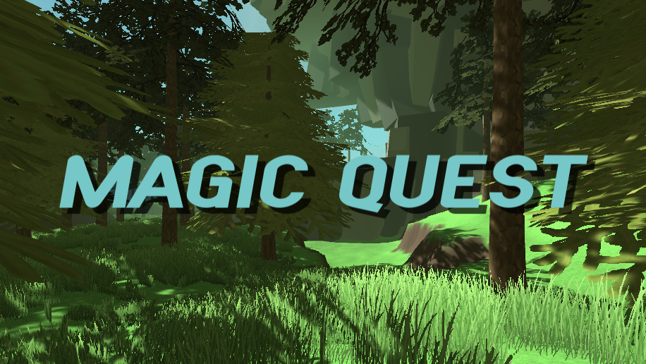
P101 - Group 4
Cesc Bausà Bosom
Berta Benet Cugat
Maria Elena Budan

Slide 2
Magic Quest
Video Game
Adventure video game
Composed of two minigames
Collect diamonds
Climb mountain
Self-descriptive
Uses poseNet interaction system
Objective of the game:
Obtain the flower at the top of the mountain and the diamonds of the forest.

Slide 3
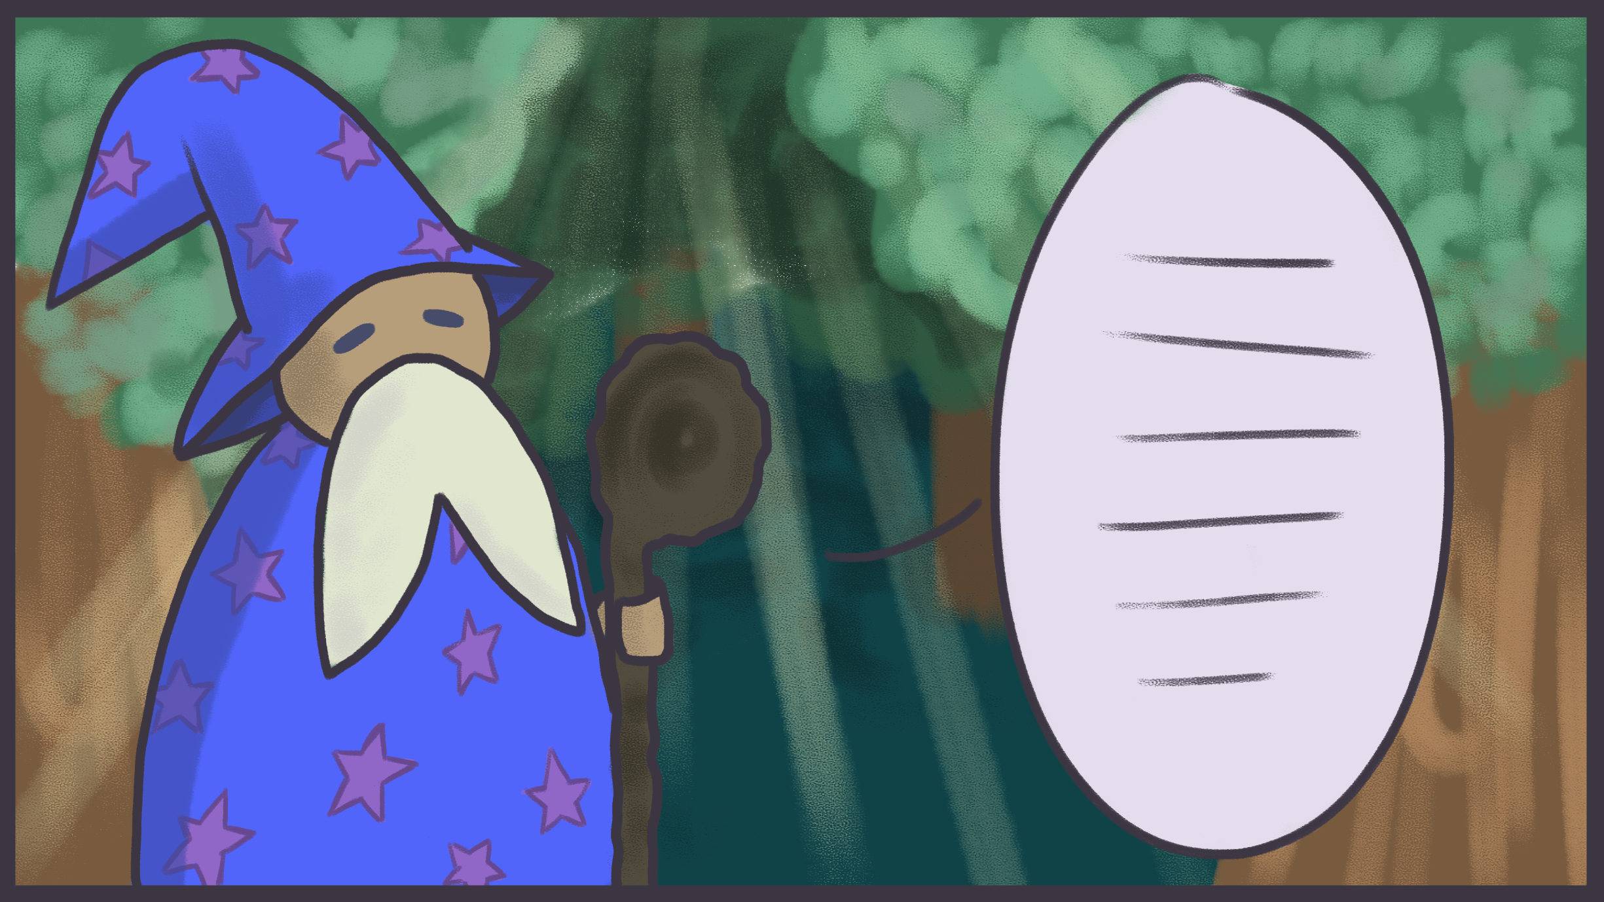
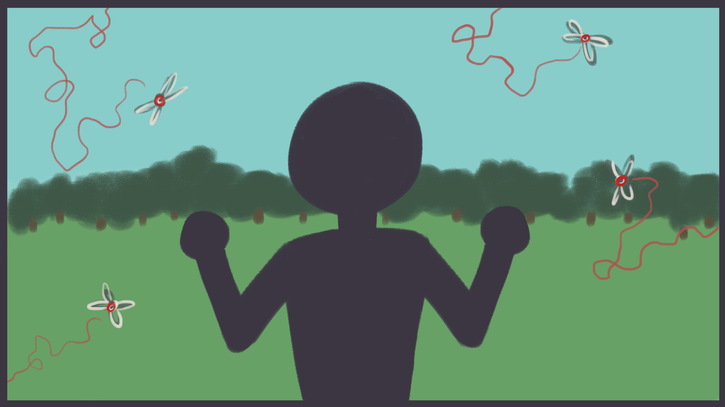
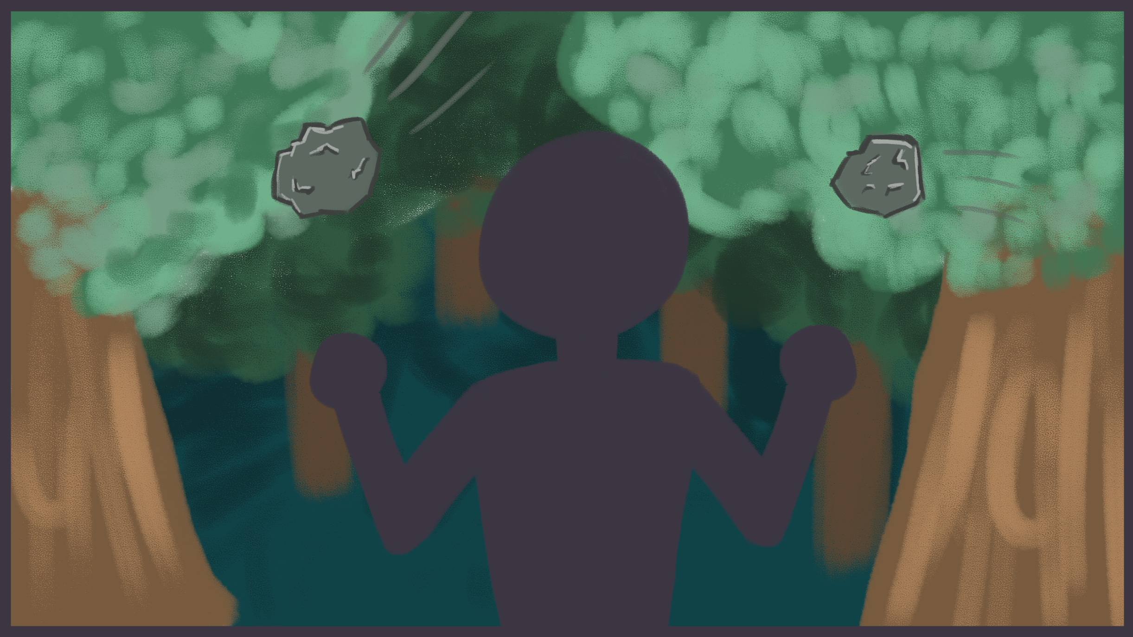
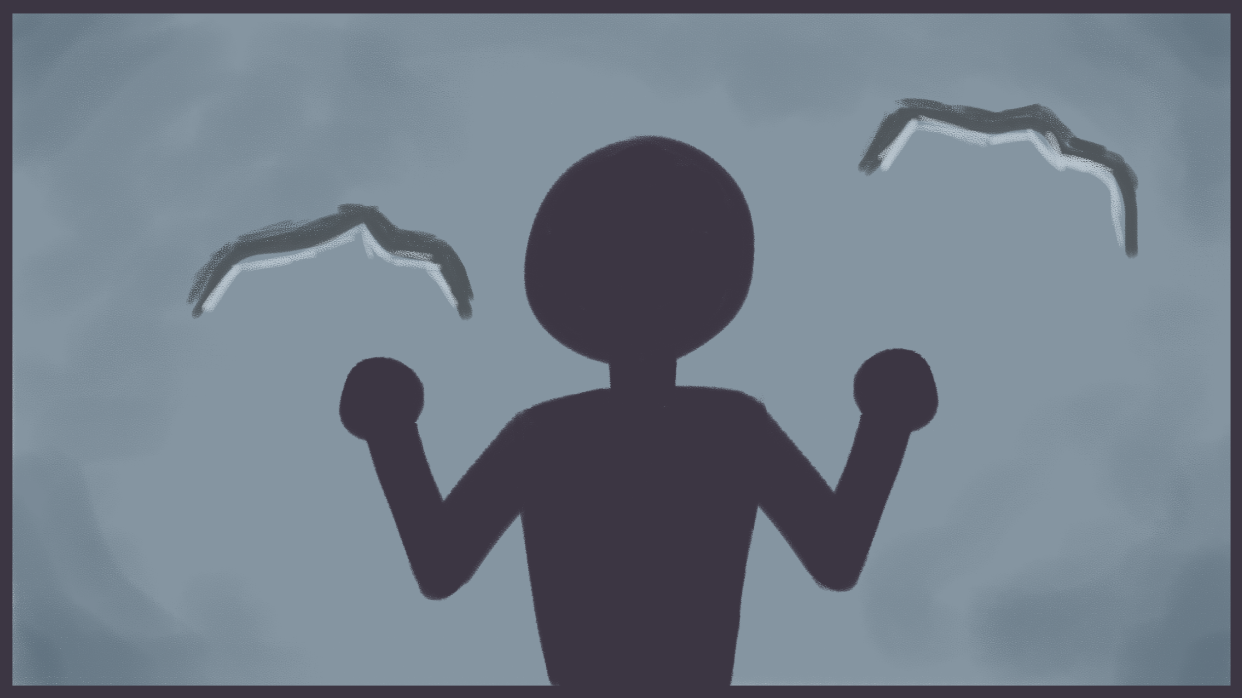
REMINDER OF STORYBOARD

Slide 4
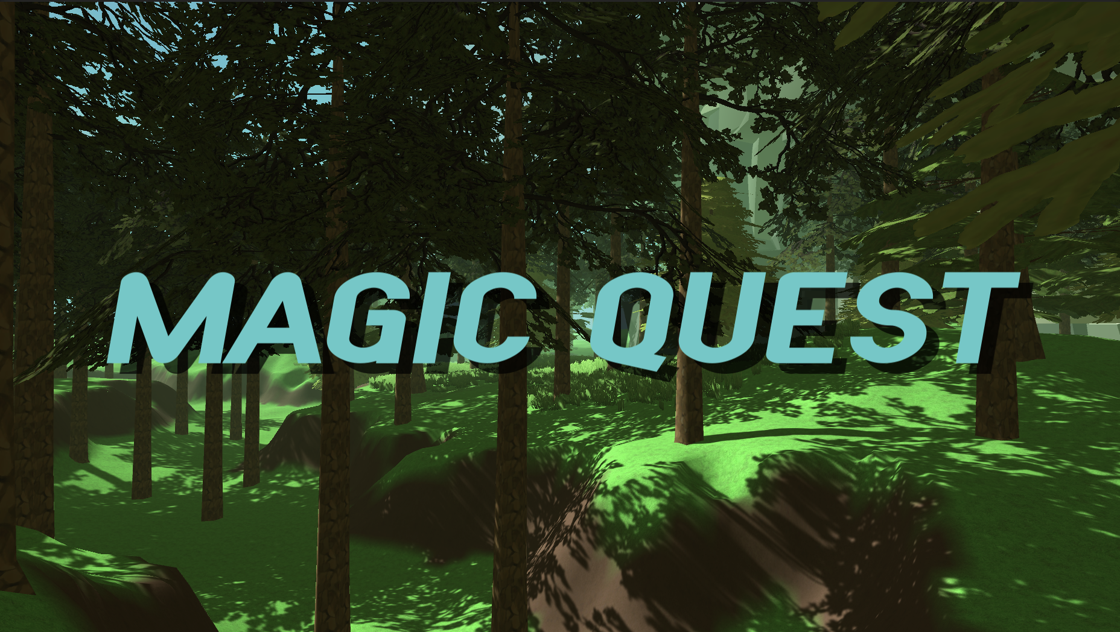
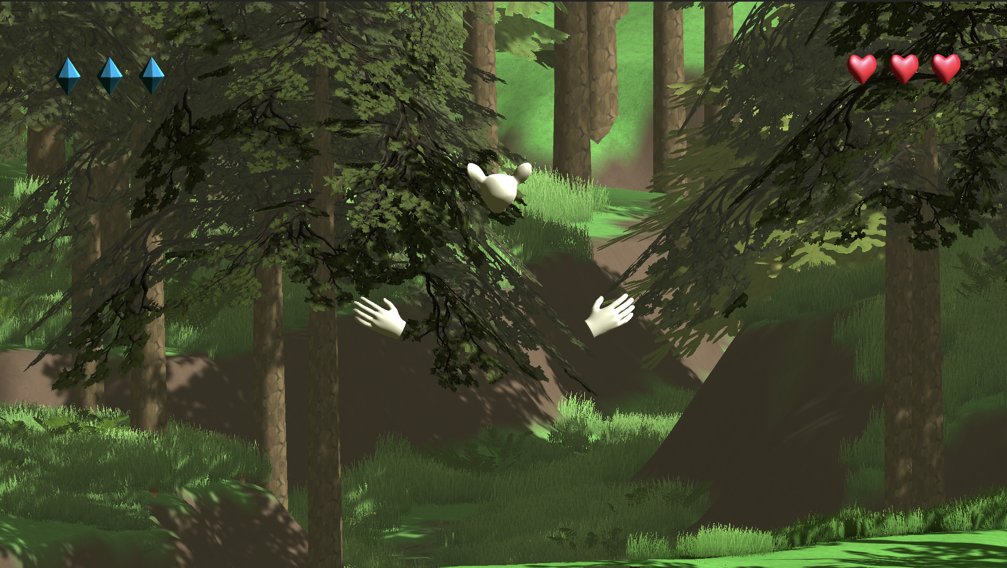
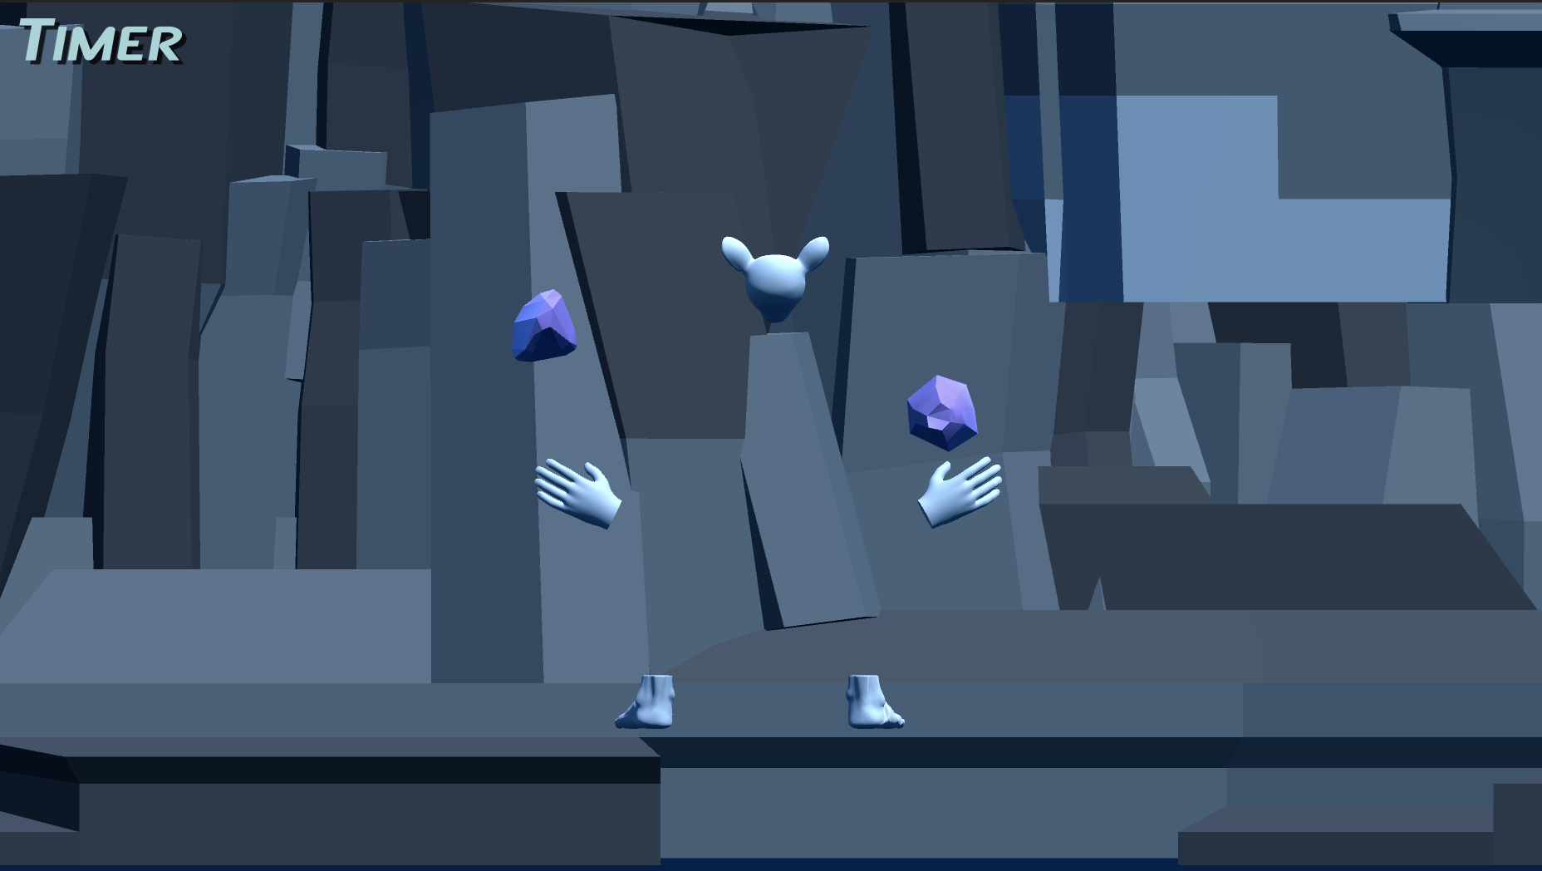
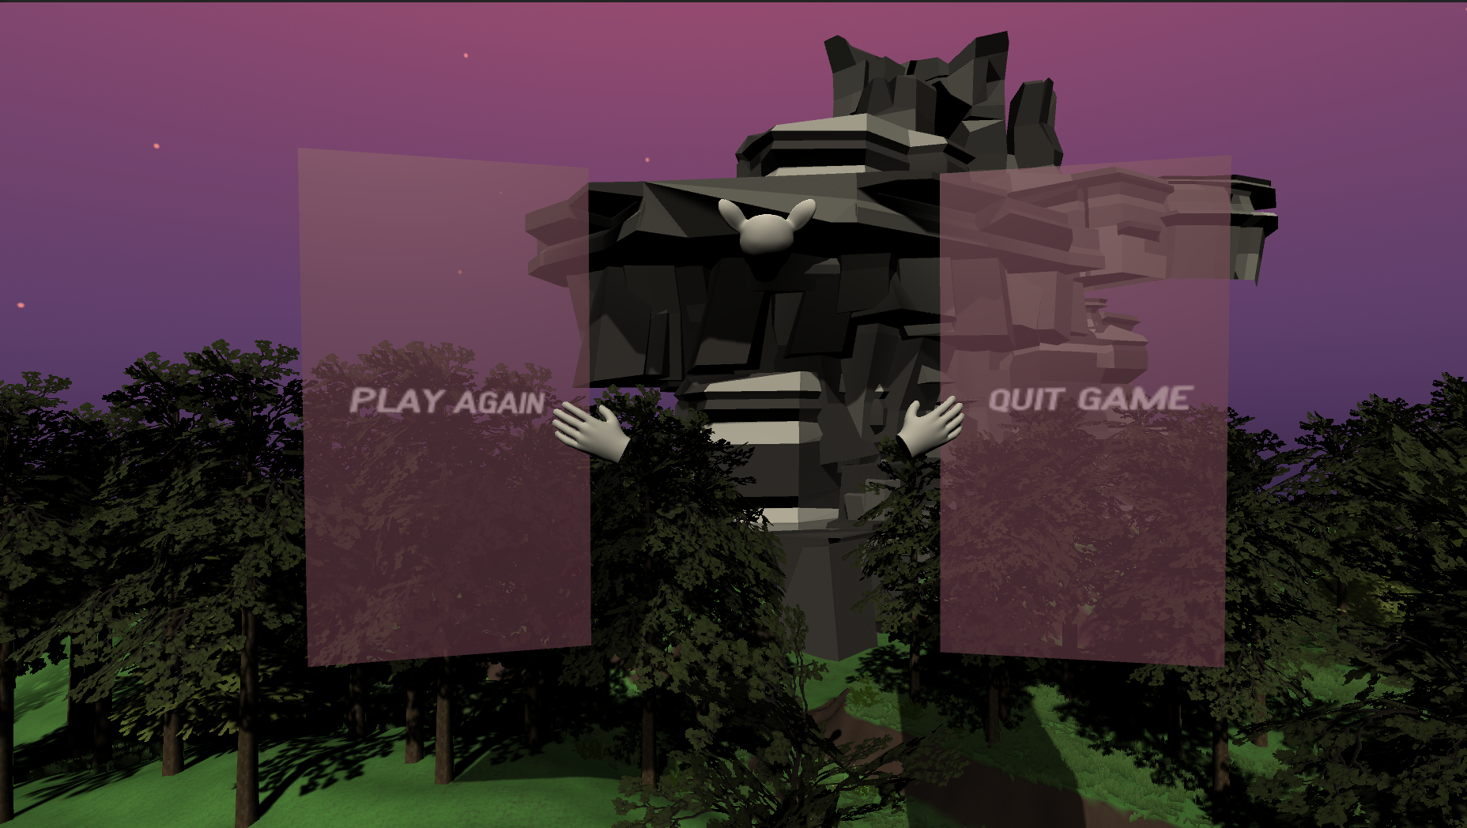
ACTUAL GAME

Slide 5
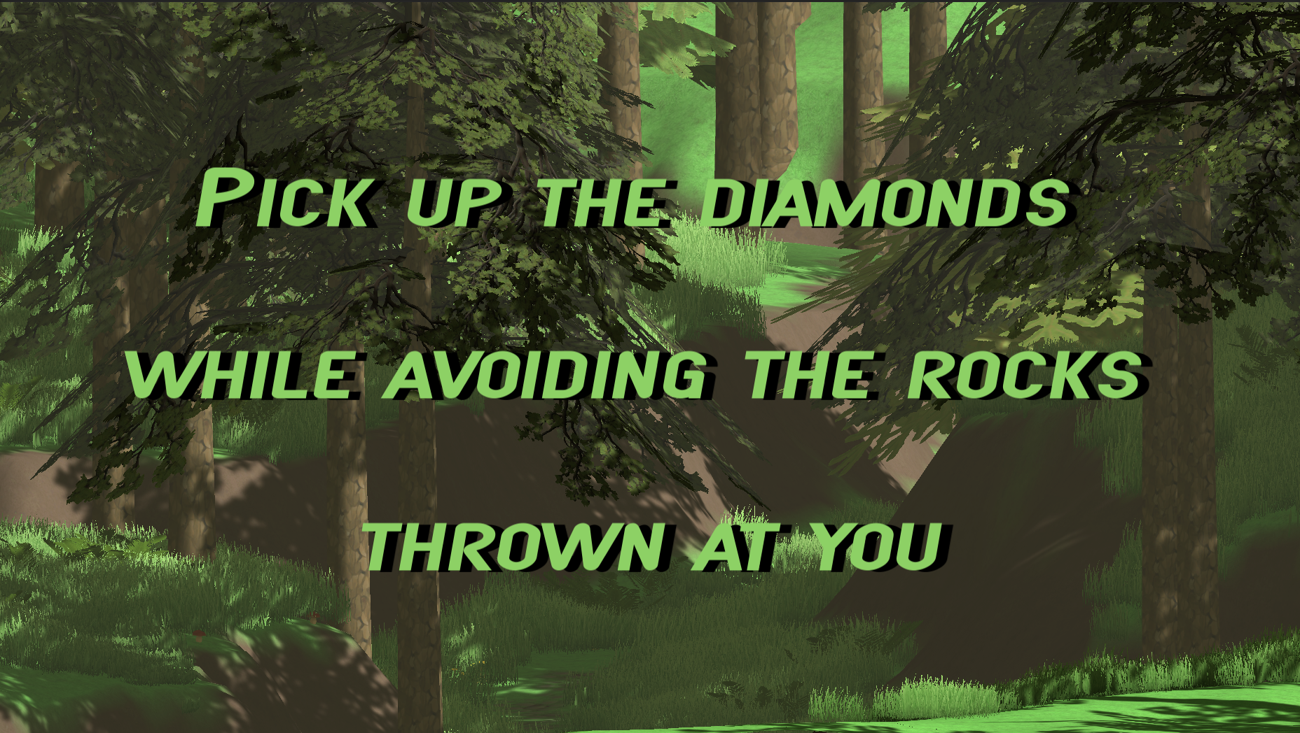
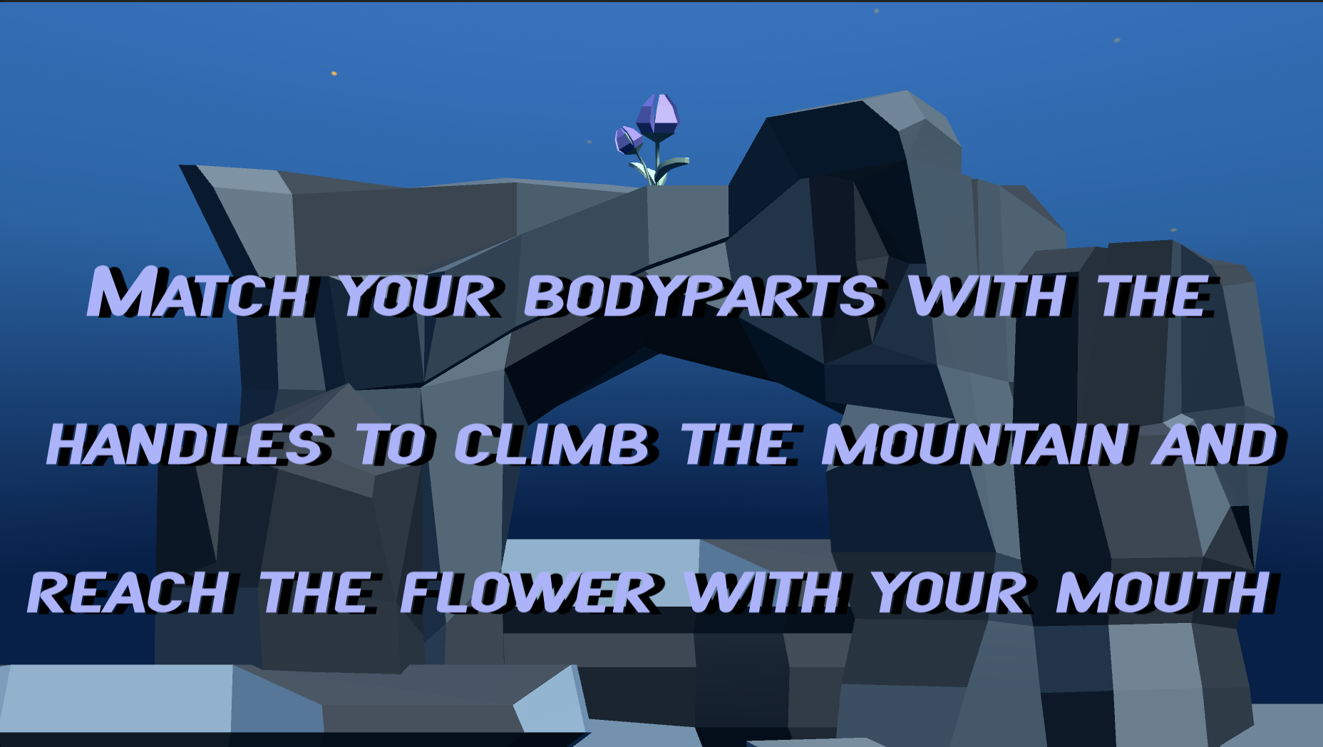
ACTUAL GAME

Slide 6
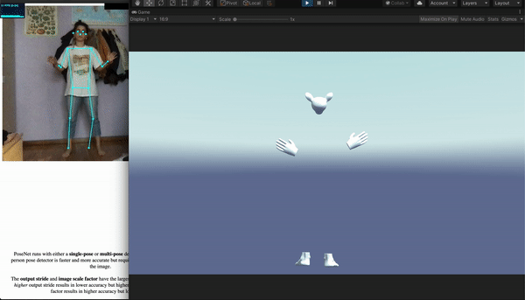
MAPPINGS

Slide 7



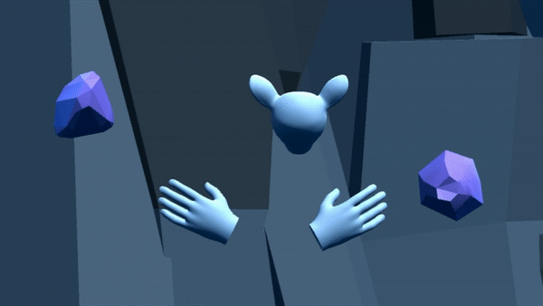
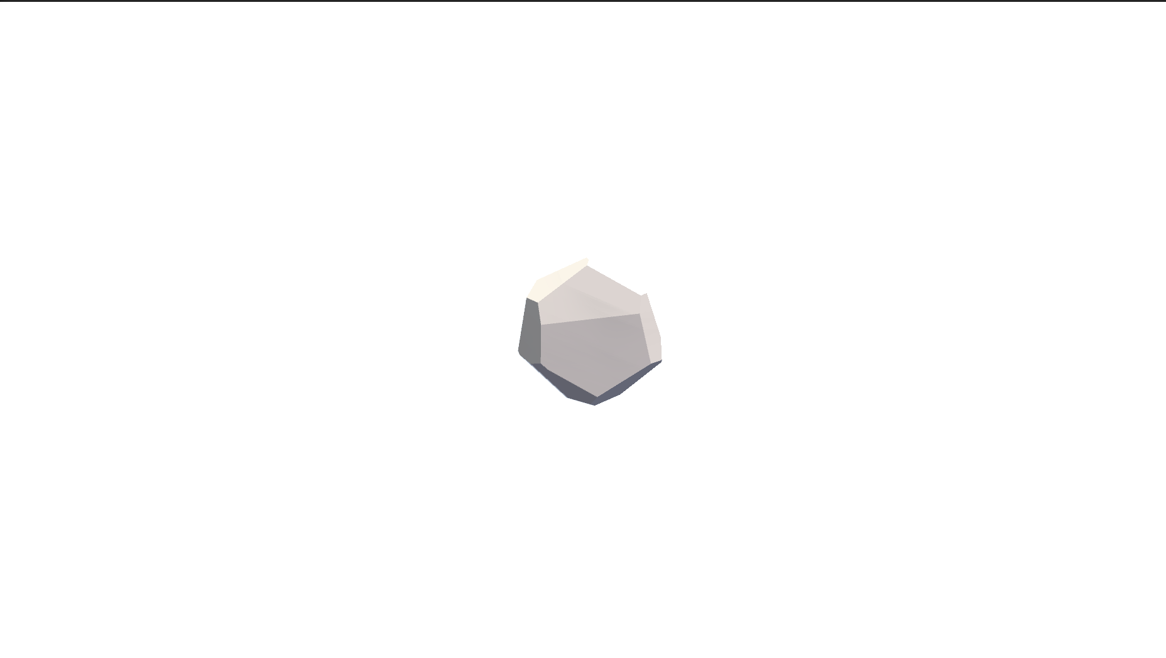
INTERACTIONS
Diamonds
Mountain
Head
Win game
Hand
Collect diamond
Head
Lose diamond
Hand
Lose diamond
Head
Lose life

Slide 8
Demo
DEMO 1: Full game
Full game recording.
Attached file: full_game.mp4
DEMO 2: Lose diamonds
Possible scenario: losing all three lives of the first minigame
Attached file: lose_diamonds.mp4
DEMO 3: Lose mountain
Possible scenario: running out of time in the second minigame
Attached file: lose_mountain.mp4

Slide 9
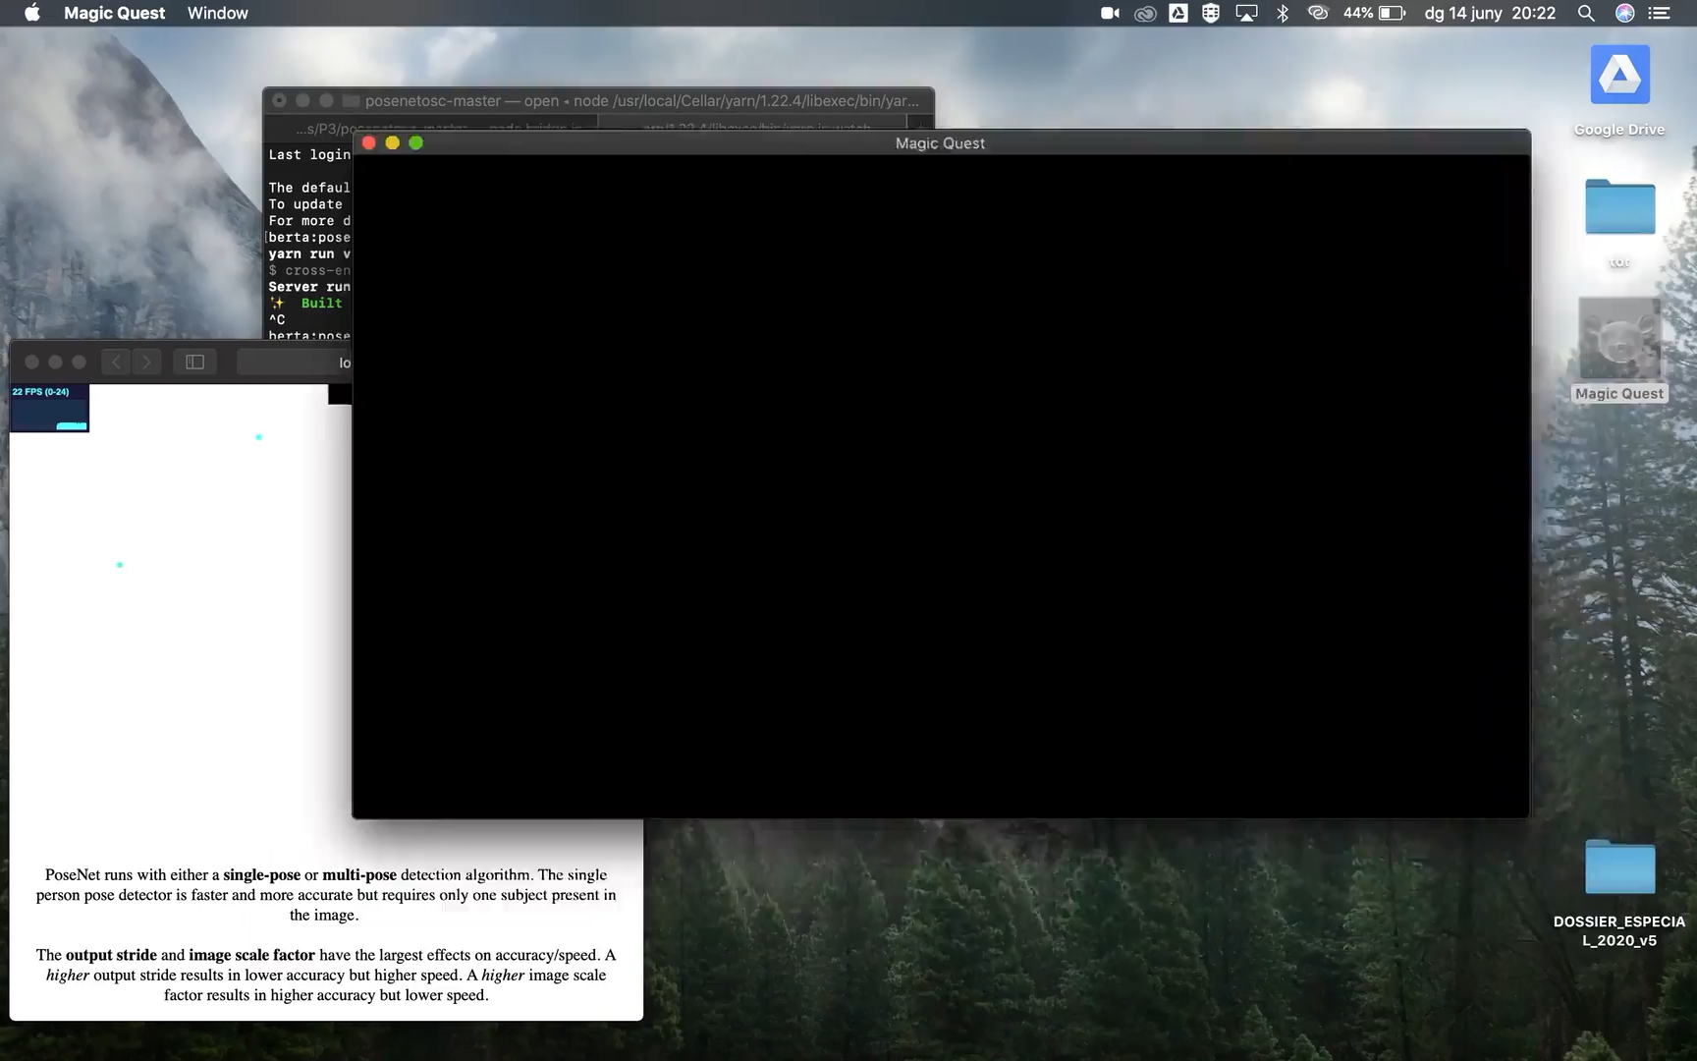

Slide 10
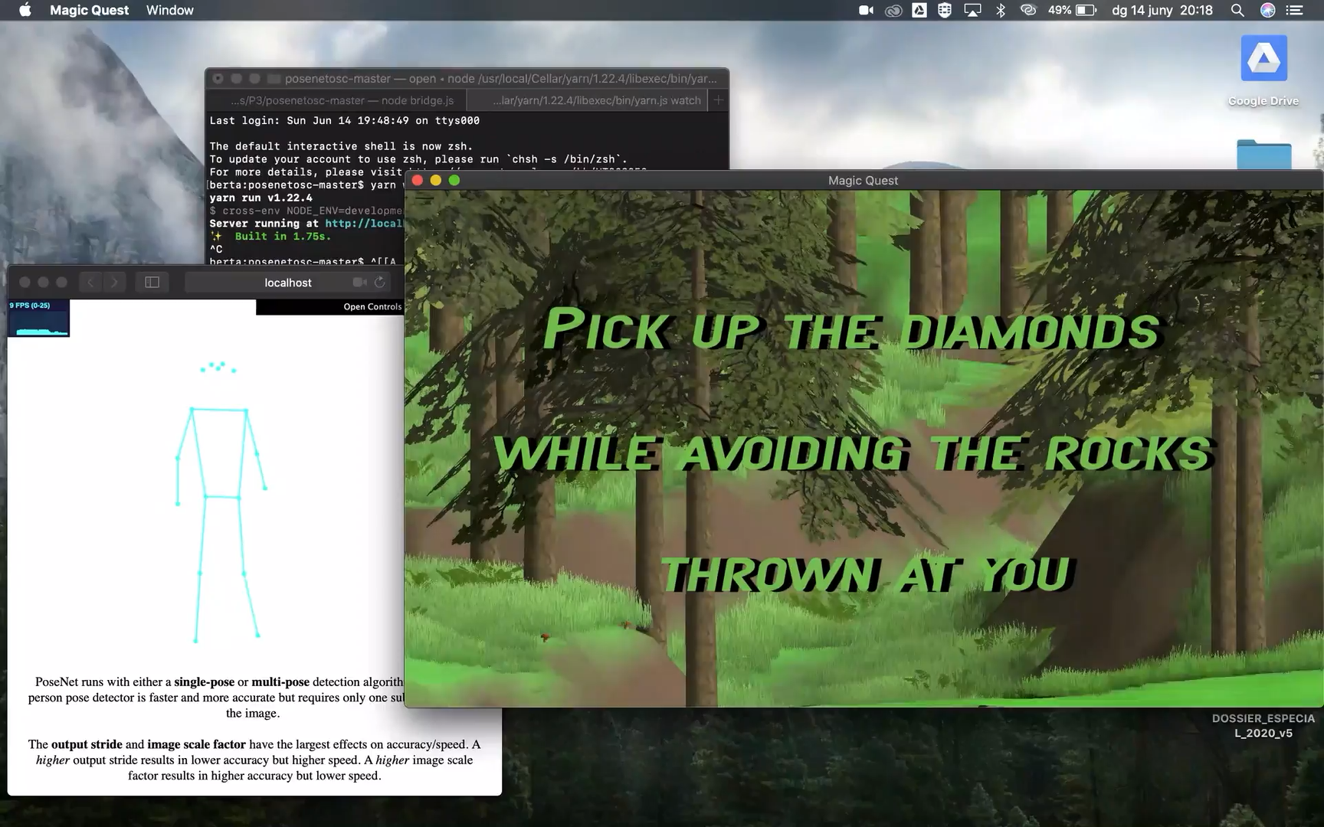

Slide 11
